Slide 1
Weekly Meeting
Feb 9, 2022
Gwangwoo Kim

Slide 2
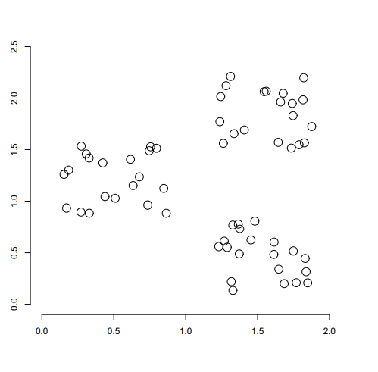
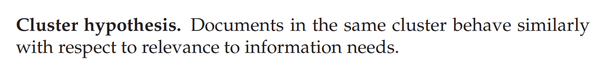
16. Flat clustering

Slide 3
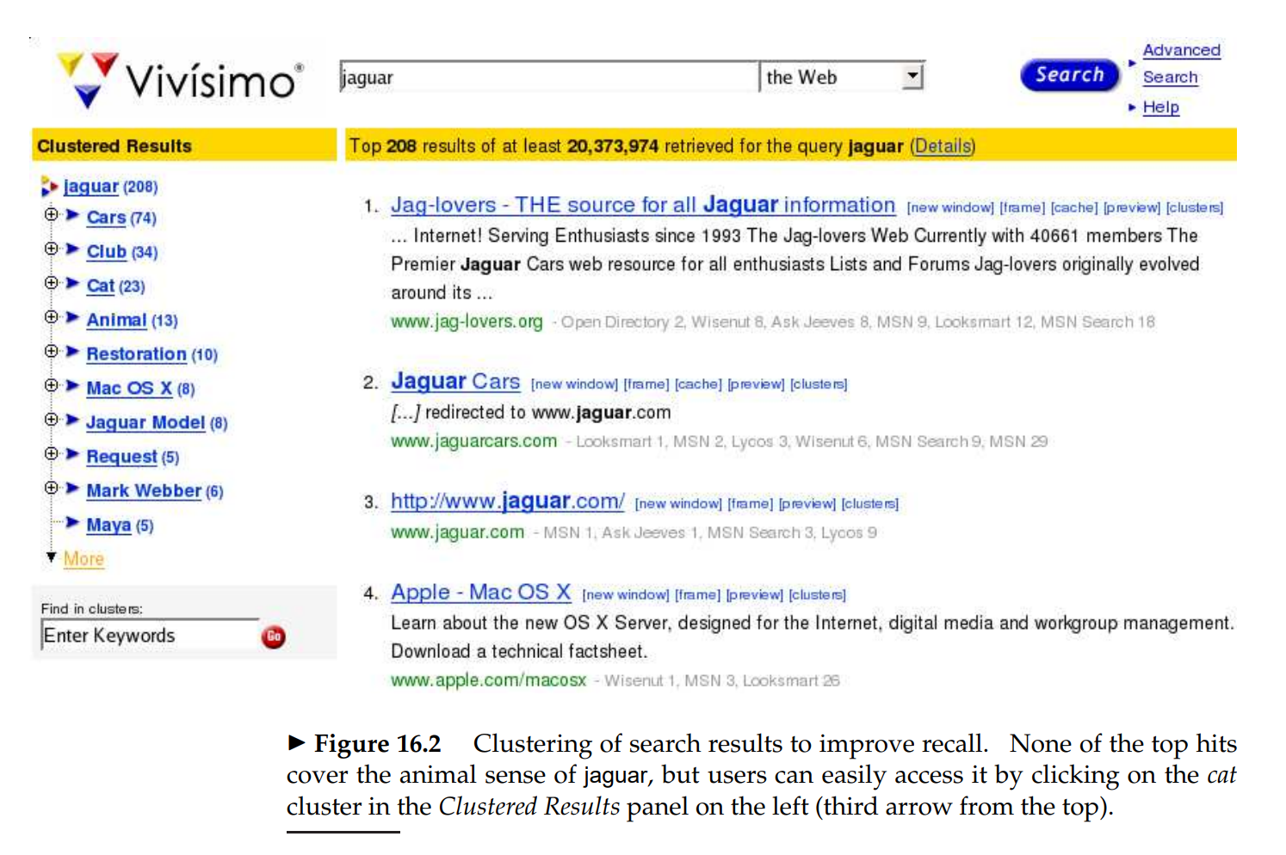
16.1 Clustering in information retrieval

Slide 4
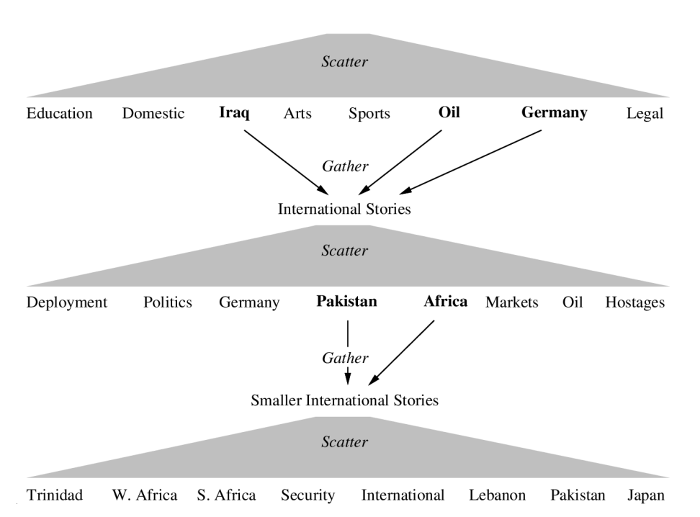
16.1 Clustering in information retrieval

Slide 5
16.3 Evaluation of clustering
internal criterion: high intra-cluster similarity and low inter-cluster similarity
external criterion: use a set of classes in an evaluation benchmark or gold standard;
Purity
Normalized mutual information (NMI)
Rand index
F measure

Slide 6
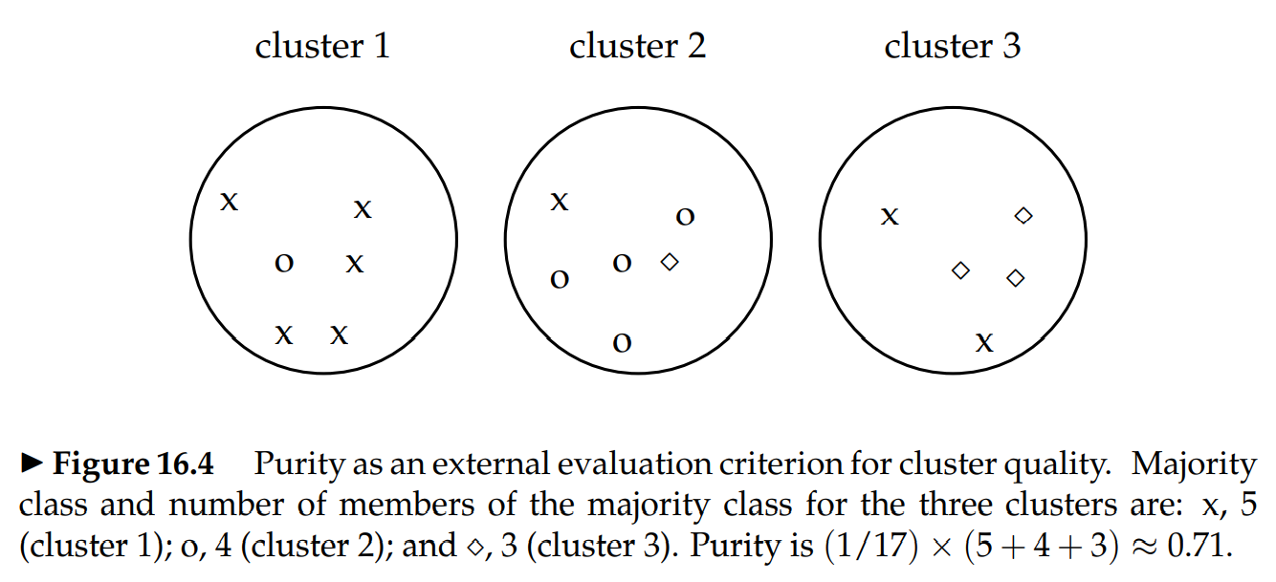
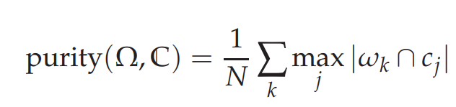
16.3 Evaluation of clustering
<Note> This criterion depends on the size of clusters

Slide 7
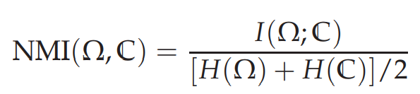
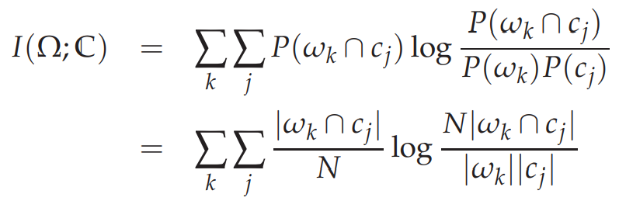
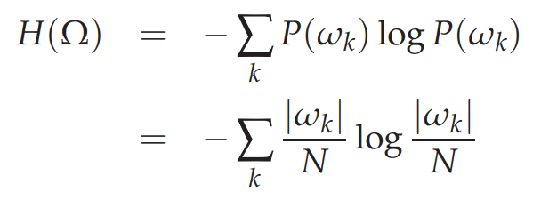
16.3 Evaluation of clustering
<Note> H-normalization fixes the cluster problem

Slide 8
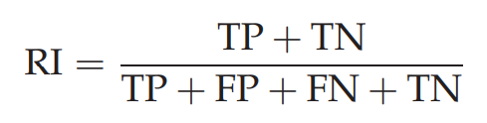
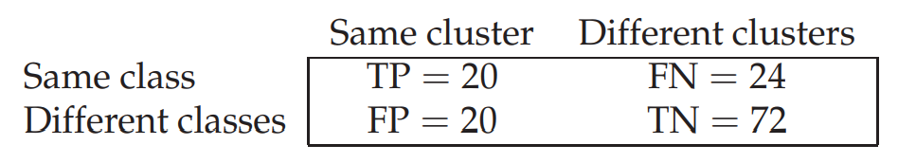
16.3 Evaluation of clustering

Slide 9
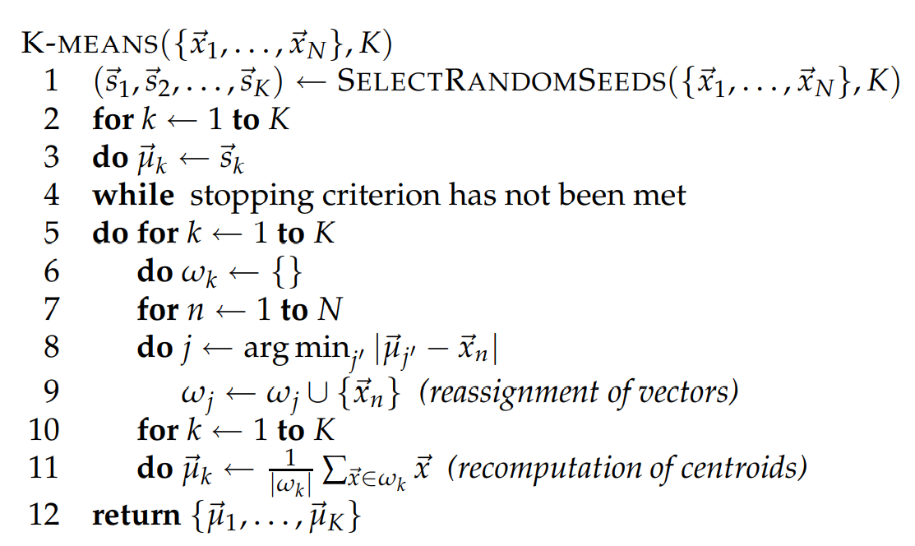
16.4 K-means

Slide 10
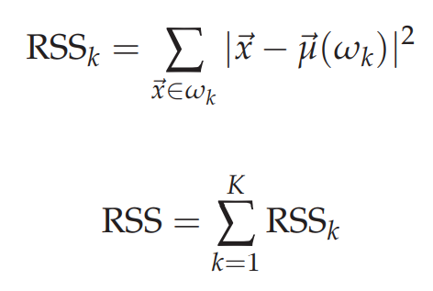
16.4 K-means
A fixed number of iterations has been completed.
Assignment of documents to does not change between iterations.
Centroids do not change between iterations.
Terminate when RSS falls below a threshold.
Terminate when the decrease in RSS falls below a threshold.

Slide 11
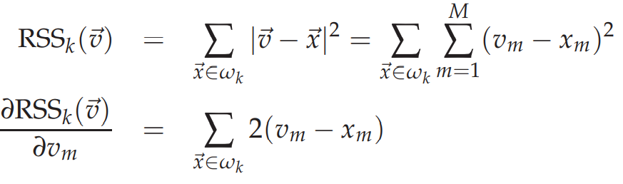
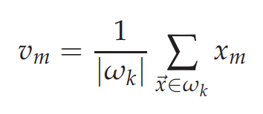
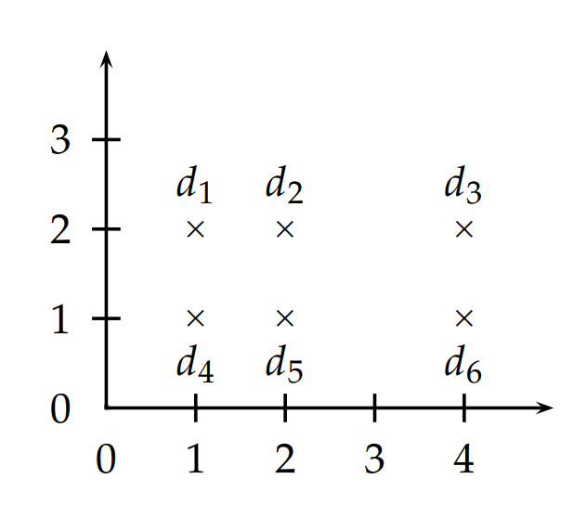
16.4 Convergence of RSS
<Remarks>
There may be several equidistant centroids.
The algorithm can cycle forever in a loop of clusterings that have the same cost.
The outcome of clustering in K-means depends on the initial seeds.
If an outlier is chosen as an initial seed,
then no other vector is assigned to it during subsequent iterations

Slide 12
16.4 Effective heuristics for seed selection
Excluding outliers from the seed set;
trying out multiple starting points and choosing the clustering with lowest cost
obtaining seeds from another method such as hierarchical clustering

Slide 13
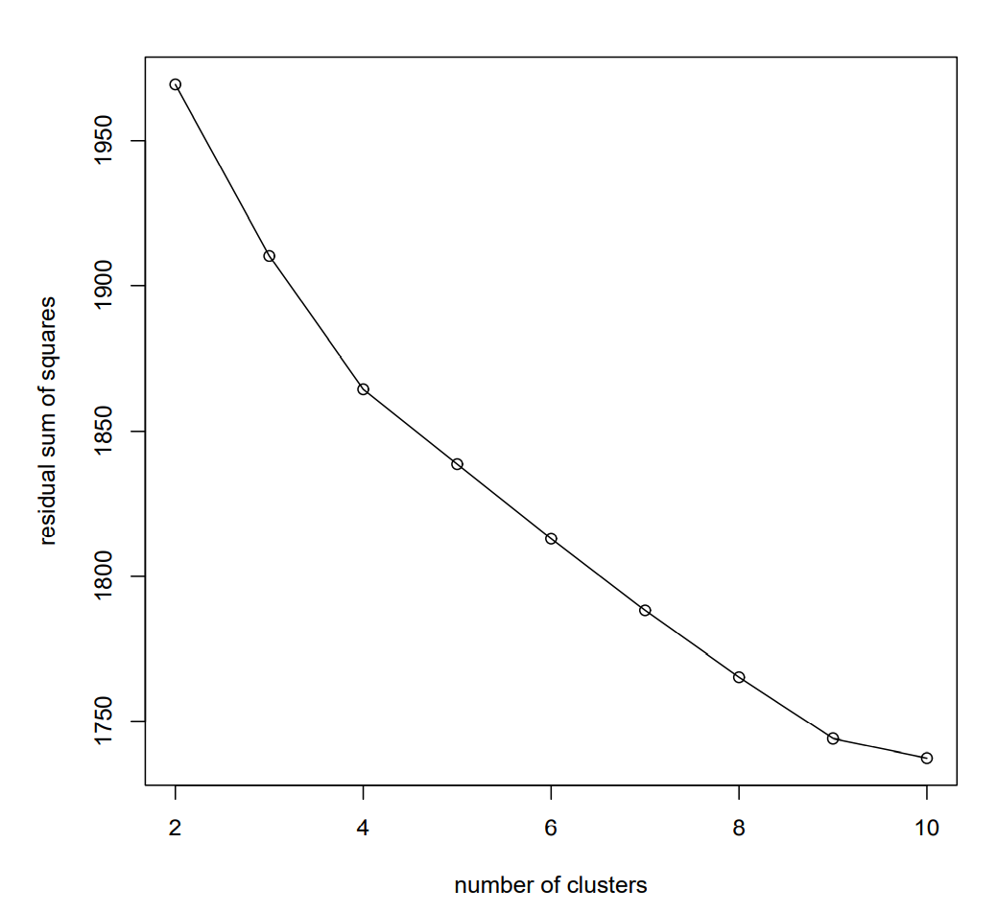

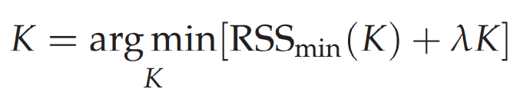
16.4.1 Cluster cardinality in K-means
How to select lambda?

Slide 14
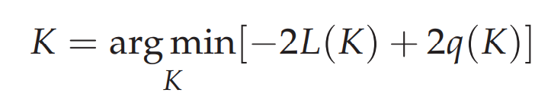
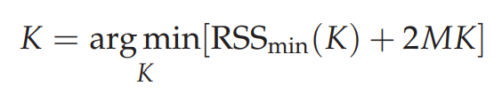
16.4.1 Cluster cardinality in K-means
In another way,
distortion
complexity
M=dim
Akaike Information Criterion (AIC)
K-means
But in practice, the previous loss is more useful.

Slide 15


16.5 Model-based clustering
Estimate
MLE
Fixed parameters theta, we can compute an assignment probability

Slide 16
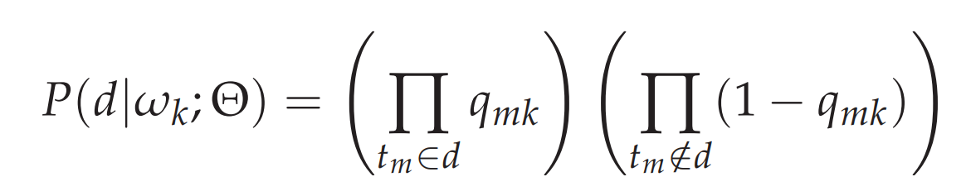
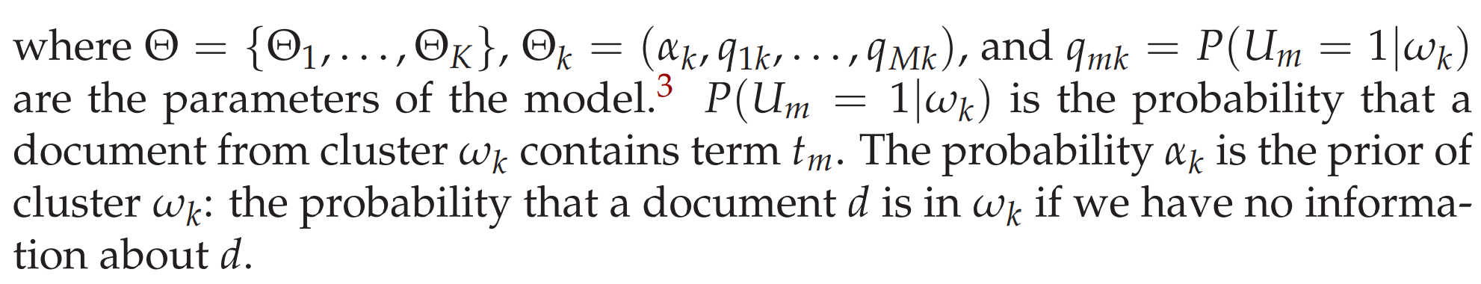
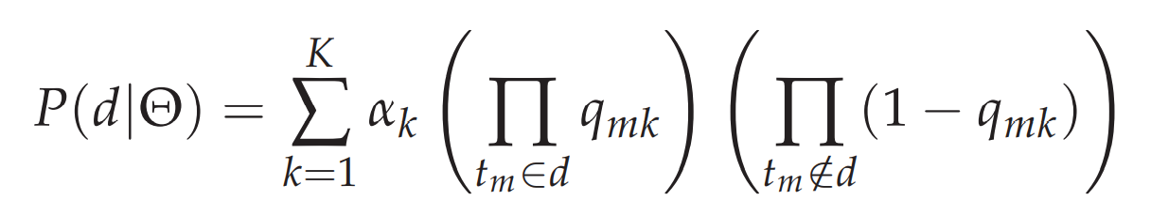
16.5 EM algorithm

Slide 17
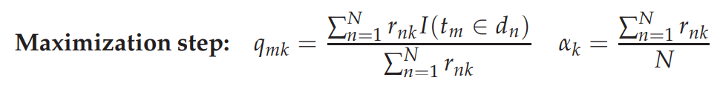
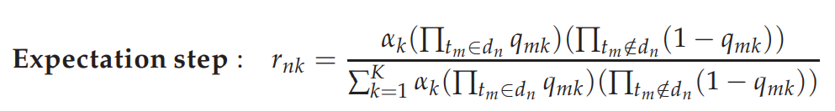
16.5 EM algorithm

Slide 18
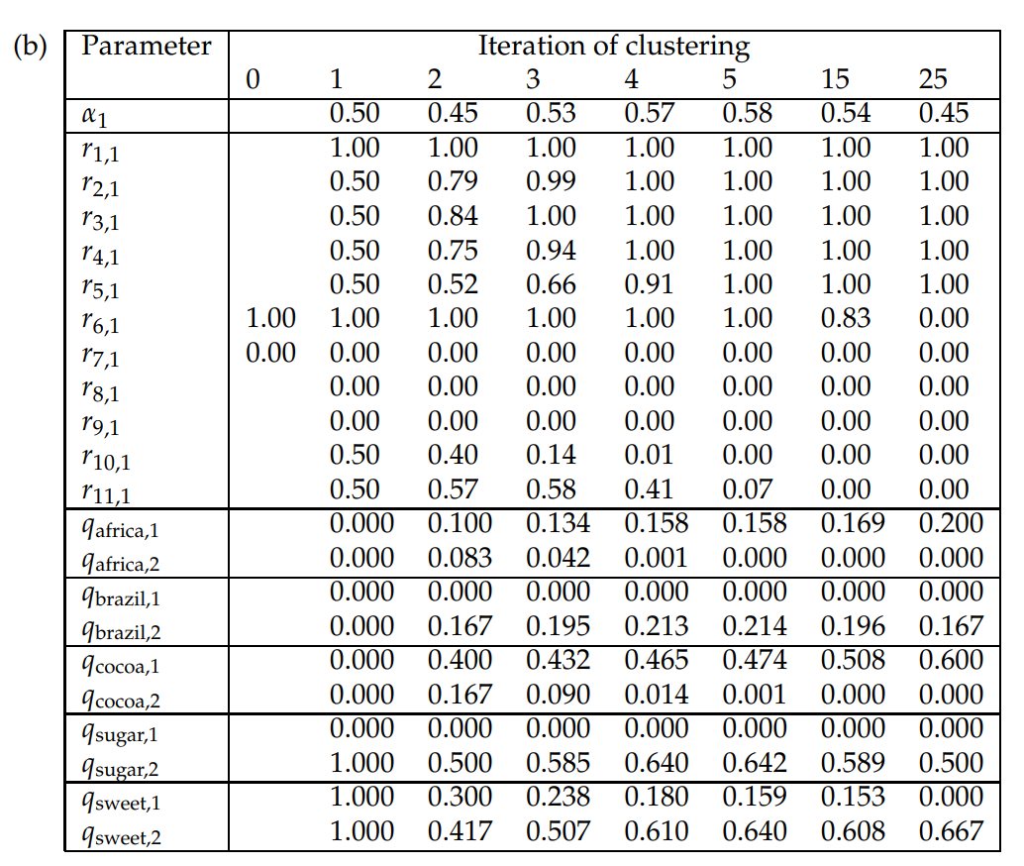
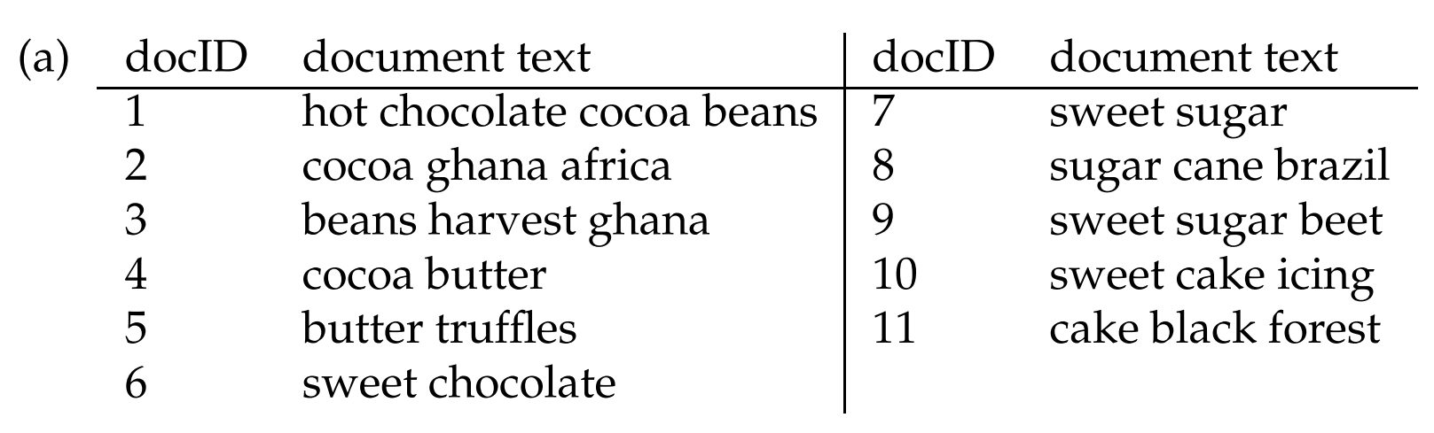
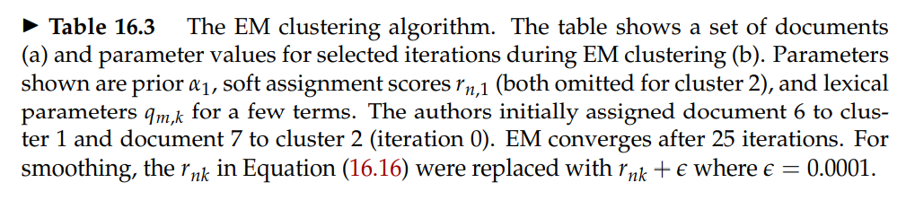
16.5 EM algorithm

Slide 19
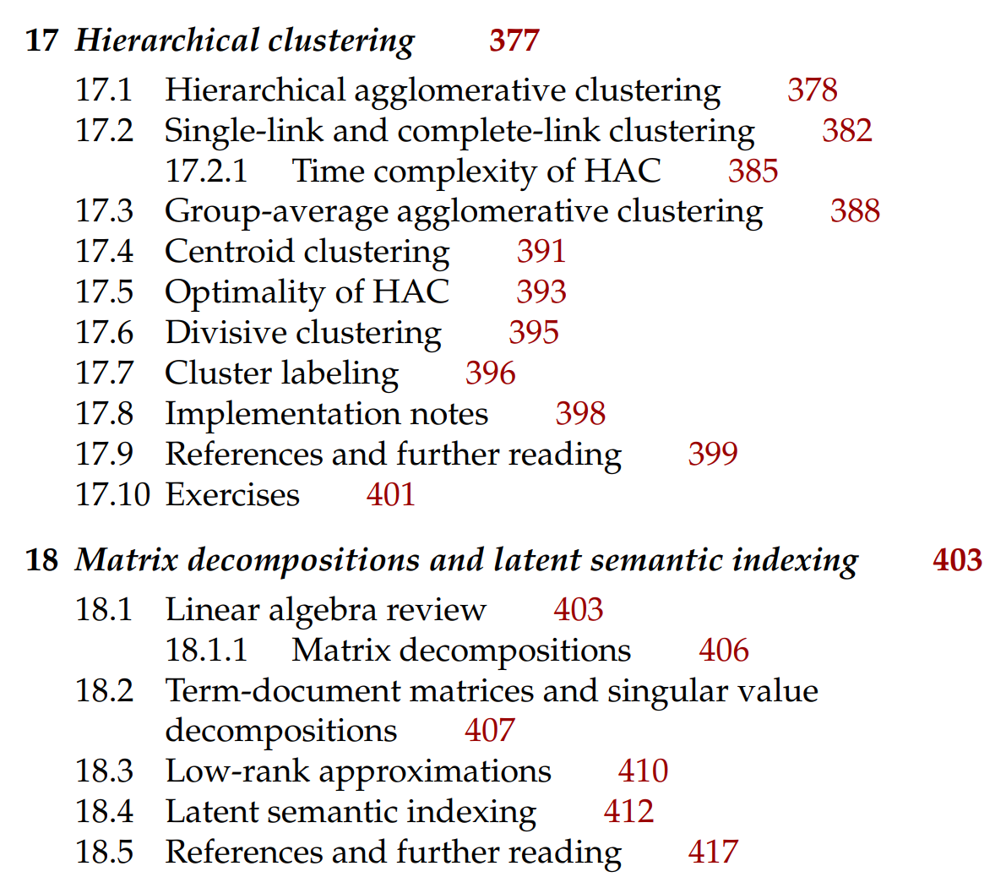
Next

